Slide 1
CSC 362: System Programming
Lecture 7
Original slides by: Amitabha Dey
Adapted by: Dr. Richard Johnson
Department of Computer Science University of North Carolina at Greensboro

Slide 2

Status Check
malloc
calloc
realloc
free
What we will cover today
Preprocessor directives
#define
#if
#ifdef
#ifndef
#undef
Macro Expansions - simple vs parameterized
File Inclusion
Notes:
Objectives
Understand the role of the preprocessor in C programming.
Learn to use various preprocessor directives like #define, #include, and conditional compilation.
Explore the concepts of macros and their advantages/disadvantages.

Slide 3
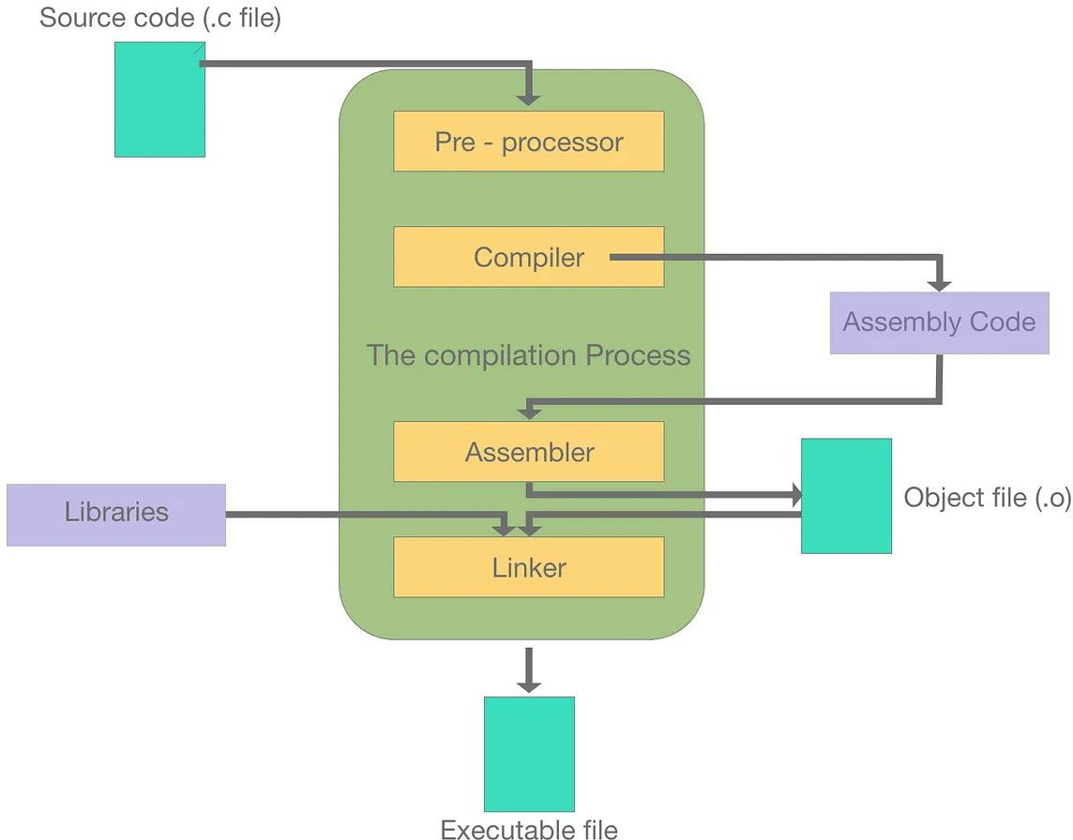

C Preprocessor
Overview
Run Code triggers the entire process, including preprocessing, compilation, linking, and execution.
Image credit - Joel Dumortier @ Medium
Notes:
Introduction to Preprocessor
The preprocessor is a program that processes the source code before it is passed to the compiler.
It operates on lines that begin with a # symbol, known as preprocessor directives.
The preprocessor does not understand C syntax; it performs simple text substitution.
The Compilation Process showing a vertical stack of four components:
Pre-processor,
Compiler,
Assembler,
and Linker.
It tracks the flow
from Source code (.c file) at the top
to an Executable file at the bottom,
with side paths for Assembly Code, Libraries, and Object files (.o)

Slide 4
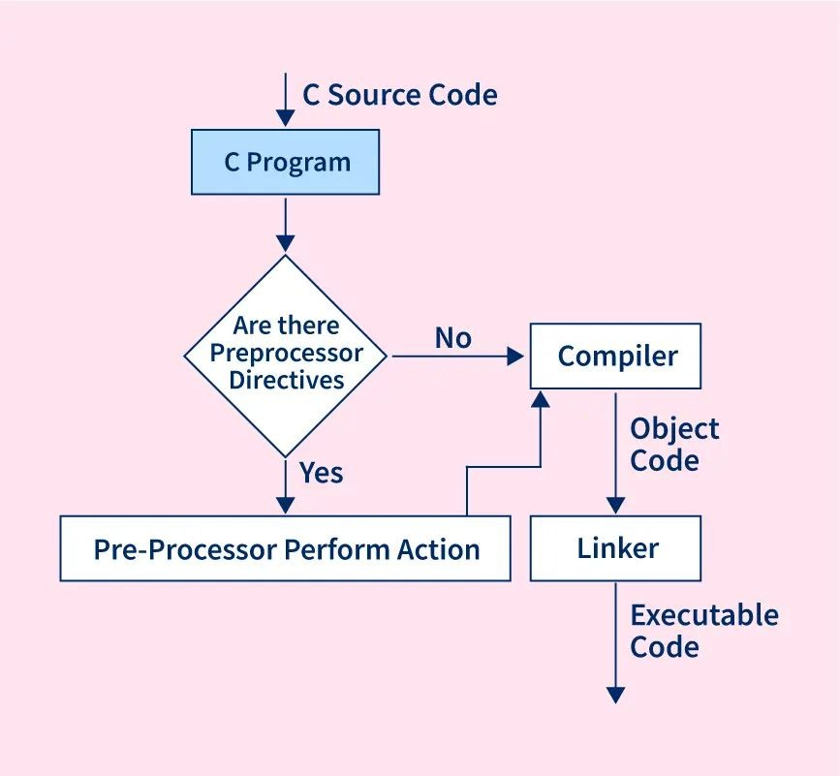
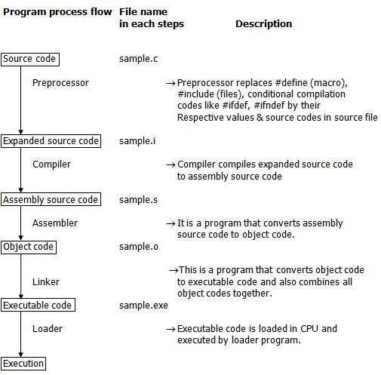
C Preprocessor Steps
Image credit - https://www.scaler.com/
Image credit - https://www.fresh2refresh.com/
Notes:
Preprocessor Directives Overview
Directives are instructions to the preprocessor, not the compiler.
They always start with # in the first column and do not end with a semicolon (;).
Categories include Macro Substitution, File Inclusion, and Conditional Compilation.
The Compilation Process (Visual)
Flow:
Source Program (.c)
→ Preprocessor
→ Expanded Source Code (.i)
→ Compiler
→ Assembly Code (.s)
→ Assembler
→ Object Code (.o)
→ Linker
→ Executable.
The Loader then places the executable into memory for execution.
---
Long-form Description:
Figure 2 contains a detailed table and flowchart mapping the "Program process flow."
It lists five stages of file transformation:
sample.c (Source code) → Preprocessor → sample.i (Expanded source code)
sample.i → Compiler → sample.s (Assembly source code)
sample.s → Assembler → sample.o (Object code)
sample.o → Linker → sample.exe (Executable code)
sample.exe → Loader → Execution
The image includes text descriptions for each step,
such as the preprocessor replacing macros and the loader loading code into the CPU.

Slide 5
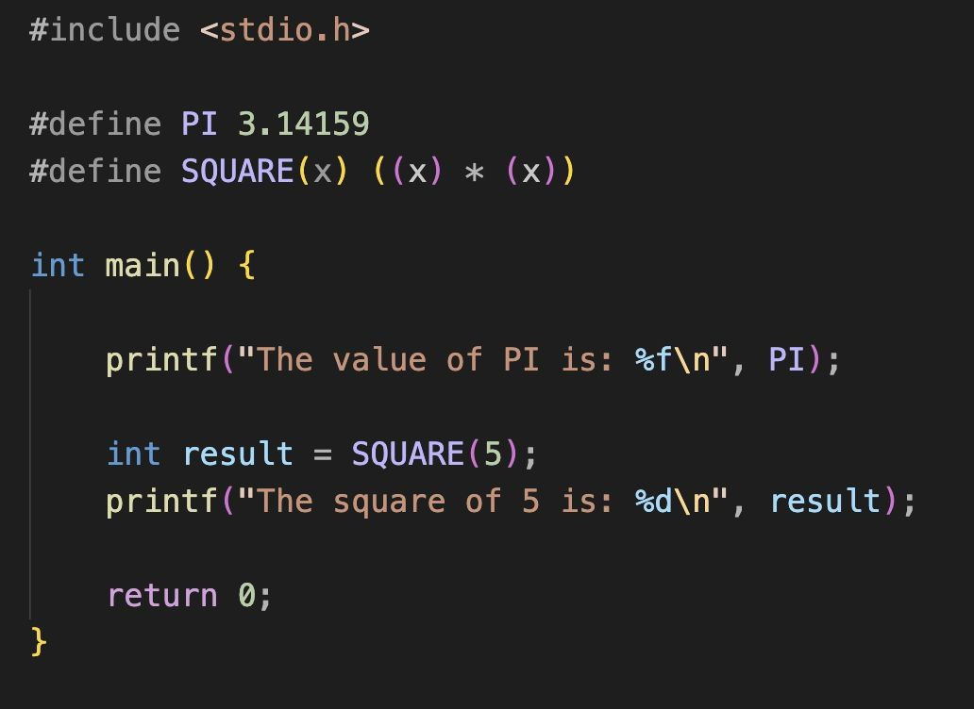
C Preprocessor
Preprocessor Directives
#define: Creates a macro.
A macro created by #define is essentially a preprocessor directive that allows you to define constants or functions that are replaced directly in the code during the preprocessing stage, before actual compilation begins.
To view the preprocessed output:
gcc -E filename.c -o output.i
-E: Runs only the preprocessor stage, stopping before compilation.
Notes:
Macro Substitution - #define
Used to define identifiers that are replaced by a string or value before compilation.
Syntax:
#define identifier string.
Example:
#define PI 3.14159 replaces every instance of PI with 3.14159.
Macros with Parameters (Function-like Macros)
Macros can take arguments, similar to functions.
Example:
#define SQUARE(x) ((x) * (x)).
These are faster than functions because there is no function call overhead (stack allocation, etc.).
See example:
define.c

Slide 6
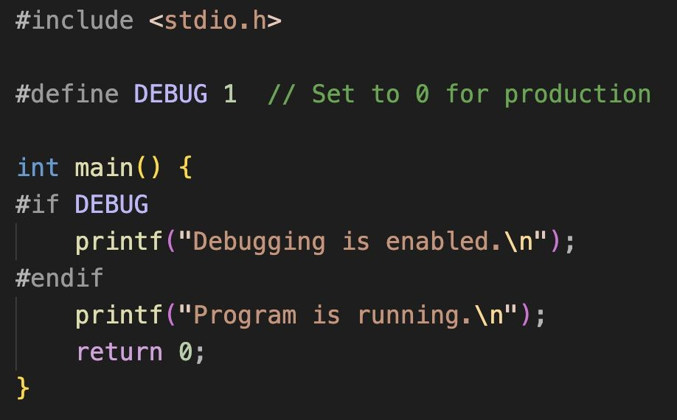
C Preprocessor Preprocessor Directives
#if: Conditional compilation based on an expression.
Used to include or exclude portions of code based on a constant expression. It allows for conditional compilation, meaning that certain parts of the code will only be compiled if the condition inside #if evaluates to true (non-zero).
#endif is part of the preprocessing phase, not runtime. It controls whether code between #if and #endif is included in the final program.
Notes:
Conditional Compilation - #if, #else, #endif
Allows the compiler to skip sections of code based on whether a condition is true.
Useful for writing portable code that behaves differently on different operating systems or hardware.
See example:
if.c

Slide 7
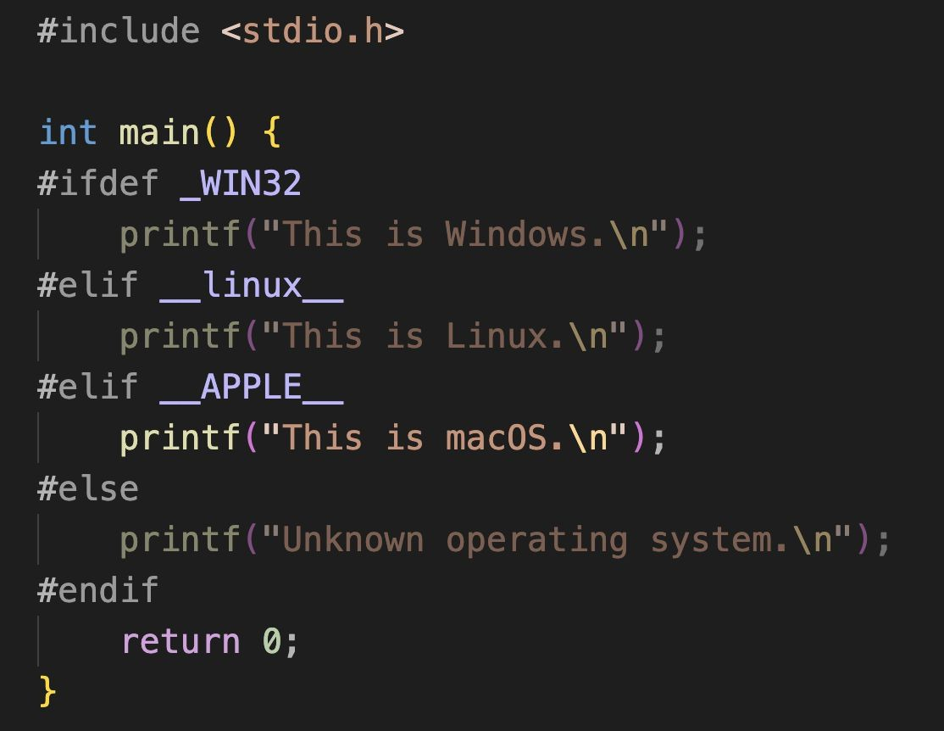
C Preprocessor
Preprocessor Directives
#ifdef: Conditional compilation if a macro is defined.
#ifdef (short for if defined) is a preprocessor directive in C used to conditionally include or exclude parts of the code based on whether a particular macro is defined. It allows you to check if a macro (usually defined with #define) is present, and if so, the code between #ifdef and #endif is included in the compilation process.
Notes:
Conditional Compilation - #ifdef and #ifndef
#ifdef DEBUG: Includes code only if the DEBUG macro is defined.
See example:
ifdef.c

Slide 8
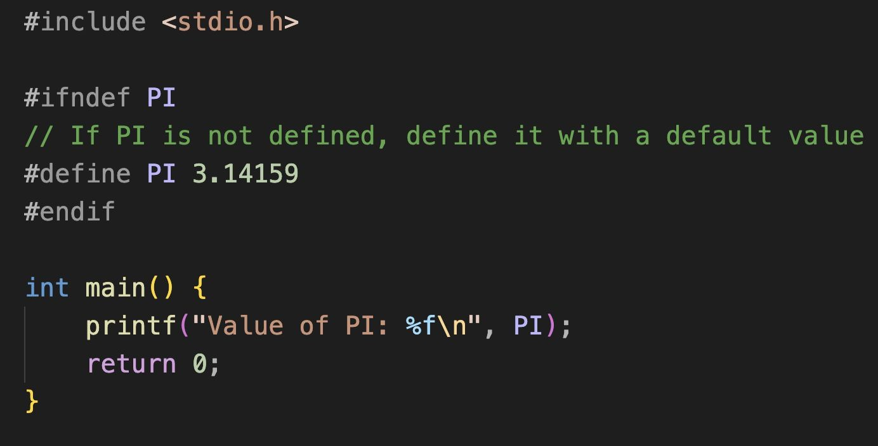
C Preprocessor
Preprocessor Directives
#ifndef: Conditional compilation if a macro is not defined.
It is mainly used for:
Header guards, to prevent multiple inclusions of the same header file.
Conditional compilation, where specific code is included only if a particular macro has not been defined.
The use of #ifndef helps in avoiding errors related to redefinitions and in writing more modular, portable, and maintainable code.
Notes:
Conditional Compilation - #ifdef and #ifndef
#ifndef PI: Defines PI only if it hasn't been defined yet.
Include Guards
Uses a combination of #ifndef, #define, and #endif in header files.
Prevents the same header from being included multiple times in the same project, which would cause "redefinition" errors.
See example:
ifndef.c

Slide 9
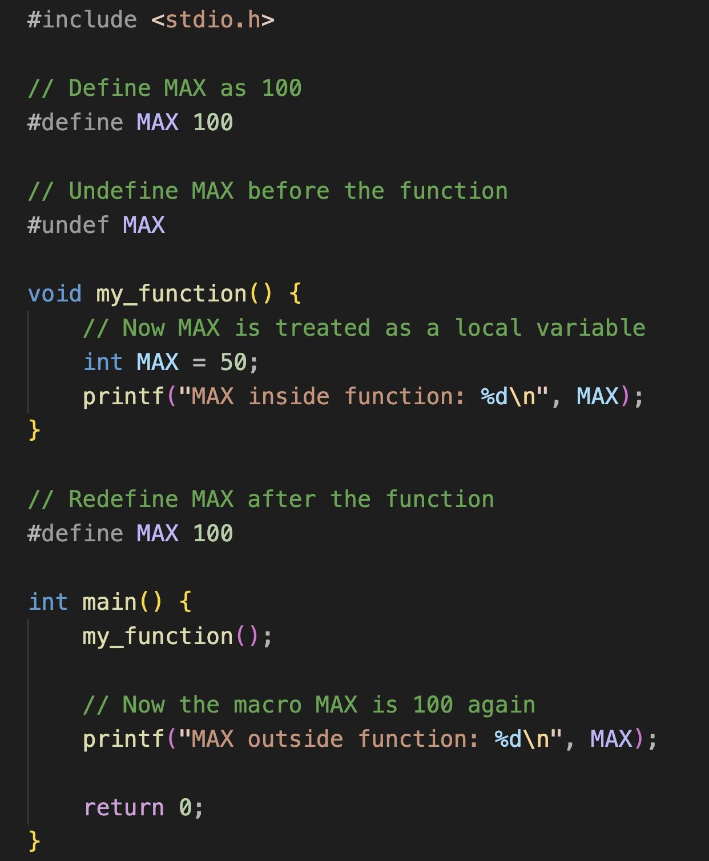
C Preprocessor Preprocessor Directives
#undef: Undefines a previously defined macro.
Used to undefine a previously defined macro. Once a macro has been undefined using #undef, it can no longer be used in the code unless it is redefined with #define.
Remove or reset a macro that was previously defined using #define.
Avoid naming conflicts by ensuring that a macro with the same name doesn’t interfere with code later.
Re-define macros to give them new values or behaviors after being undefined.
Notes:
The #undef Directive
Used to "undefine" a previously defined macro.
Syntax:
#undef identifier.
After this line, the identifier is no longer recognized as a macro by the preprocessor.
See example:
undef.c

Slide 10
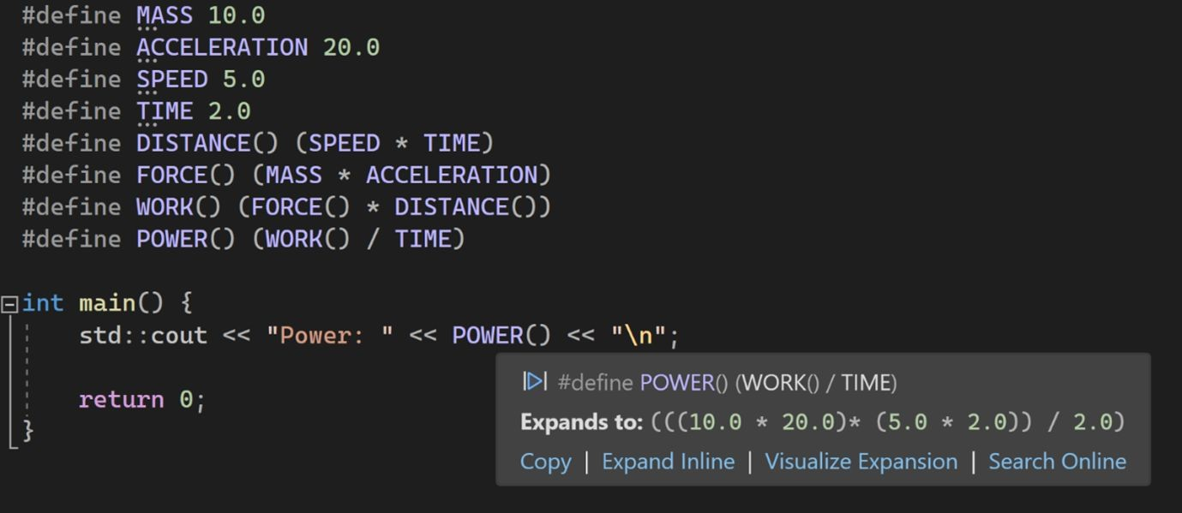
C Preprocessor Macro Expansion
In C, a macro is a fragment of code defined using the #define directive. When the code is compiled, the preprocessor replaces all instances of the macro with its definition. This process is called macro expansion.
There are two main types of macros:
Simple Macros: These are used to define constants or simple replacements.
Parameterized Macros: These macros accept arguments and can resemble functions.
Image credit - https://devblogs.microsoft.com/
Additional resource:
https://devblogs.microsoft.com/cppblog/visualize-macro-expansion-for-c/

Slide 11
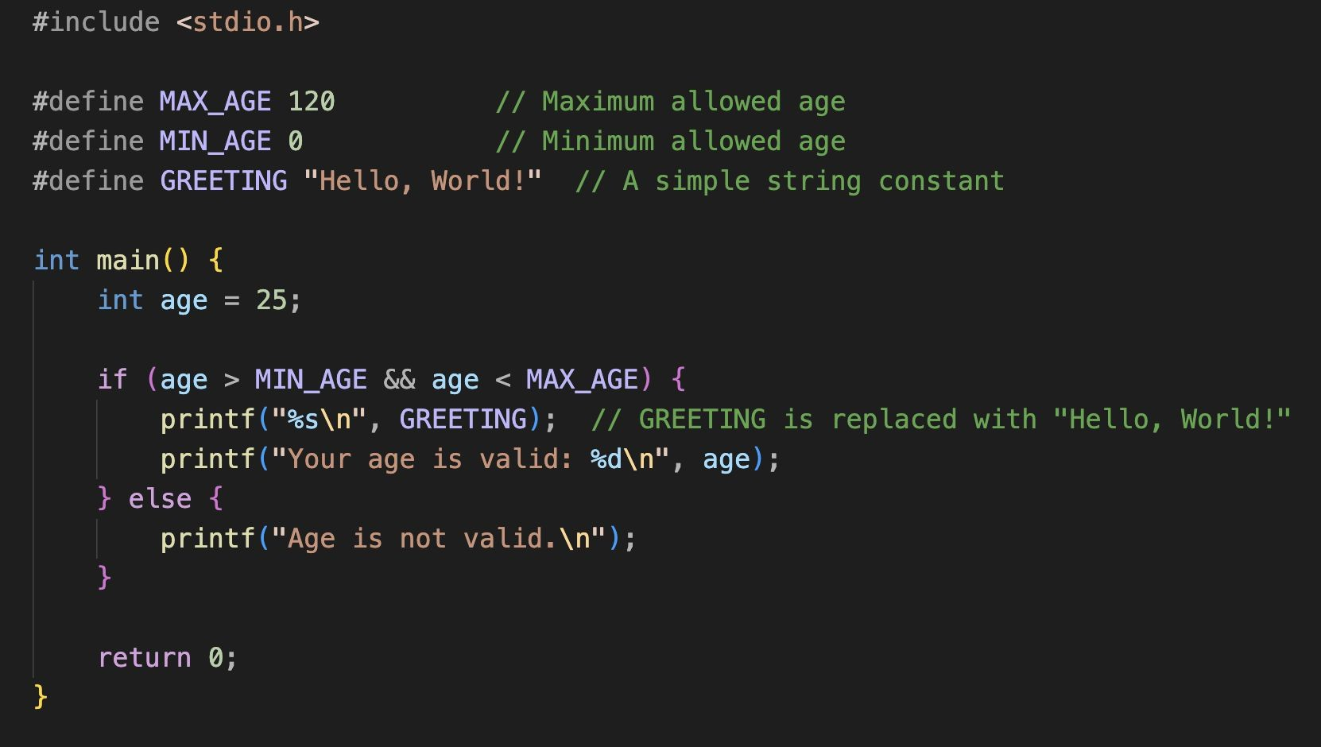
C Preprocessor
Macro Expansion
Simple Macros: These are used to define constants or simple replacements.
Notes:
See example:
simple_macro.c

Slide 12
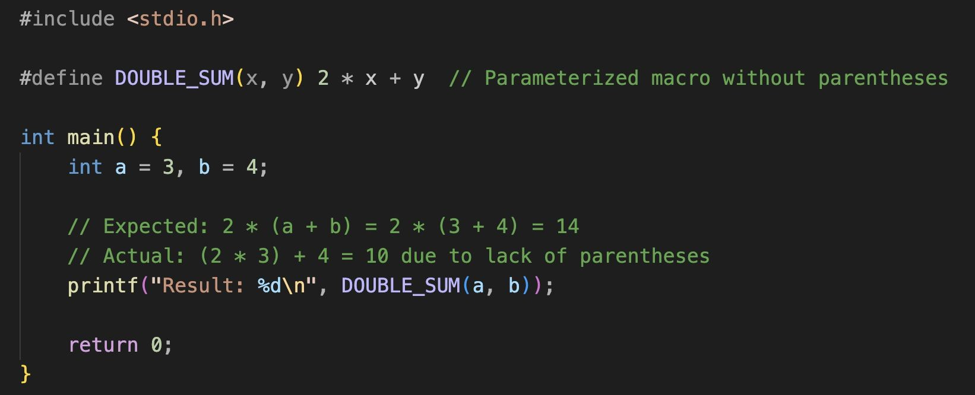
C Preprocessor
Macro Expansion
Pitfalls of macro expansion (e.g., precedence issues)
Always use parentheses in macros to ensure correct operator precedence, especially when combining addition, multiplication, and other operations.
Notes:
Macro Expansion Pitfalls
Lack of parentheses in macro definitions can lead to logical errors due to operator precedence.
Example:
SQUARE(3+4) without internal parentheses would expand to 3+4 * 3+4, resulting in 19 instead of 49.
Macros vs. Functions
Macros: Pre-processed, no type checking, no call overhead, code size increases as they are expanded in-place.
Functions: Compiled, strict type checking, involves call overhead, code size remains smaller as the function is stored in one place.
Optional:
Miscellaneous Directives (#error, #line)
#error: Forces the compiler to stop and display a specific message.
#line: Used to change the line number and filename reported by the compiler during error messages.
The #pragma Directive
Provides machine-specific or compiler-specific instructions.
Example:
#pragma startup or #pragma exit can specify functions to run before main() starts or after it ends.
Implementation varies significantly between different compilers (e.g., GCC vs. Turbo C).
See example:
param_macro.c

Slide 13
C Preprocessor File Inclusion
#include <header.h>
This form tells the preprocessor to only search for the file in the system directories where standard library header files are located (e.g., /usr/include/ on Linux or the equivalent directory on other systems).
It does not check the current directory.
Notes:
File Inclusion - #include
Tells the preprocessor to insert the contents of a specified file into the current file.
Standard syntax:
#include <filename> for system headers.

Slide 14
C Preprocessor File Inclusion
#include "header.h"
This form tells the preprocessor to first search for the file in the
current directory (the directory of the source file).
If the file is not found in the current directory, it will then search in the standard system directories.
Notes:
File Inclusion - #include
Tells the preprocessor to insert the contents of a specified file into the current file.
User-defined syntax:
#include "filename" for local files.

Slide 15
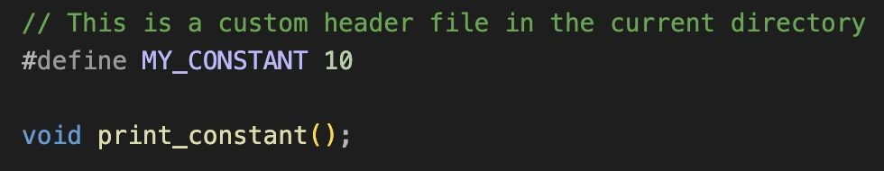
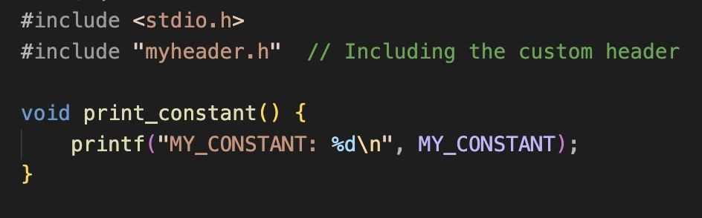
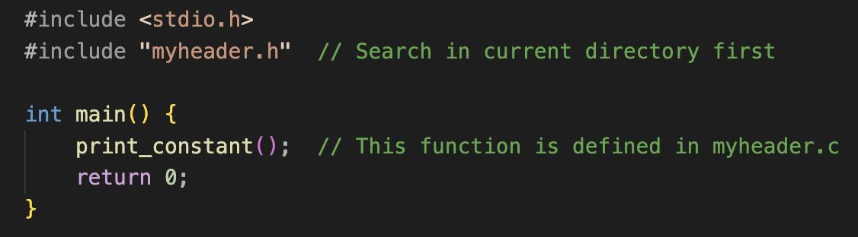
C Preprocessor
File Inclusion
myheader.h
Let's create three files:
myheader.h: A custom header file in the same directory as the source file.
myheader.c: Function called by main.c is defined here
main.c: The main C program that includes the header file.
myheader.c
main.c
Notes:
See example:
myheader.h
myheader.c
main.c

Slide 16
C Preprocessor
File Inclusion
myheader.h
Compile each .c file separately into .o files
myheader.c
gcc -c myheader.c -o myheader.o
gcc -c main.c -o main.o
Link the object files into an executable
gcc main.o myheader.o -o myprogram
main.c
Run the program
./myprogram

Slide 17
Summary Table of C Preprocessor Directives
Directive | Purpose | Key Example
#define | Creates a macro (constant or function-like) | PI 3.14159
#include | Inserts the contents of another file | <stdio.h> or "myheader.h"
#if / #endif | Includes code if a condition is true | DEBUG == 1
#ifdef | Includes code if a macro is defined | _WIN32 detection
#ifndef | Includes code if a macro is not defined | Providing default values
#undef | Removes a macro definition | Freeing a name for local use
Notes:
Conclusion / Q&A
Summary of the importance of the preprocessor in managing complex C projects.
Encouragement to use macros for constants and simple logic, while being mindful of their side effects.

